Slide 1
Introduction to Sistematic Literature Review using Publish or Perish and Mendeley
Ali Rokhman
Graduate School of Public Administration
Jenderal Soedirman University
Friday, 28 October 2022

Slide 2
Content of presentation
Brief about how to download and install PoP and Mendelay
Mendeley demo for citation
Definition, tips, and steps of systematic literature review
Using PoP
Using Mendelay
Using other tools:
Download journal
Paraphrase
Get digest
Grammarly
Find appropriate journal

Slide 3
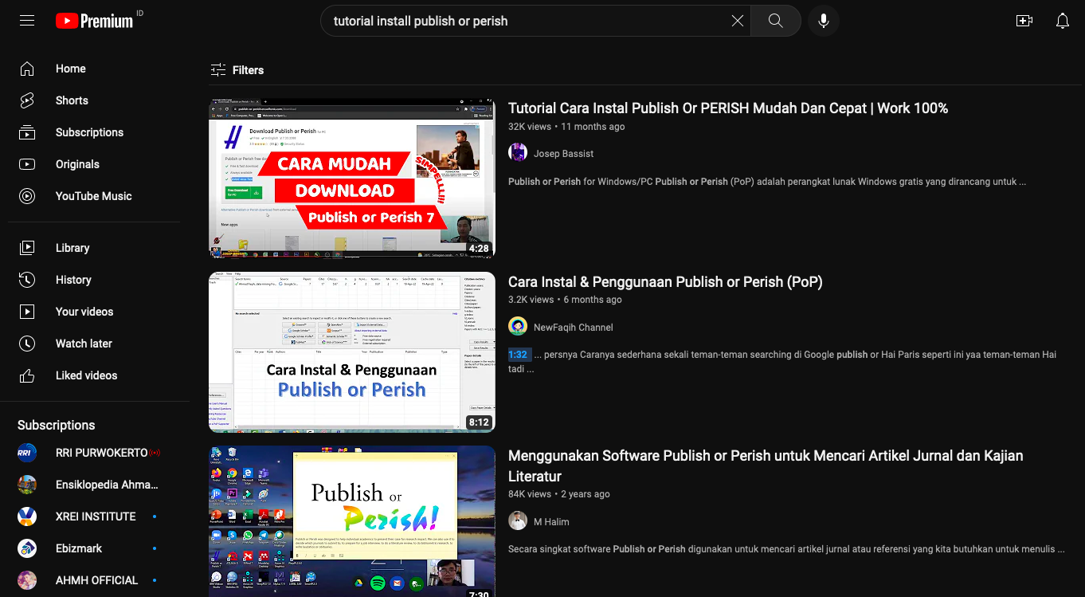

Slide 4
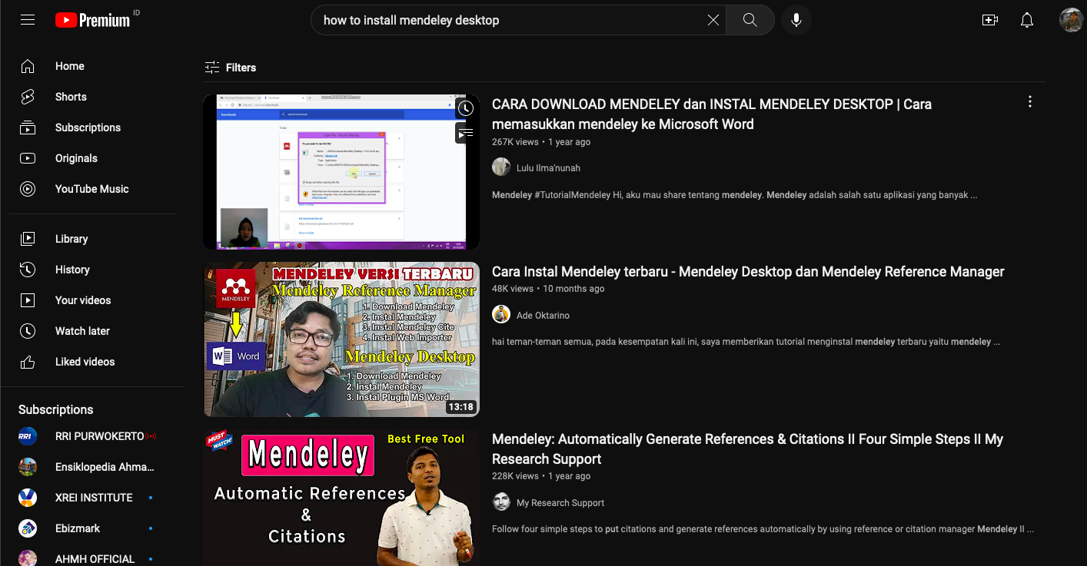

Slide 5
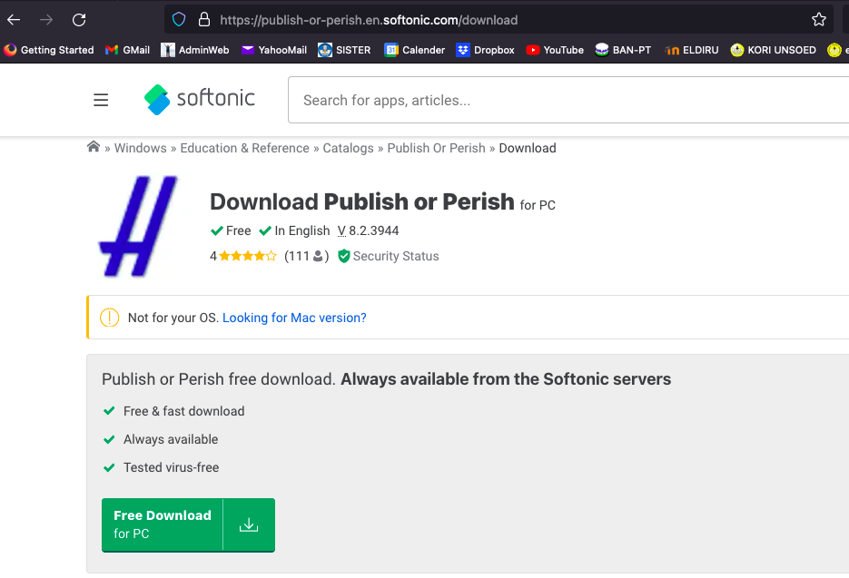

Slide 6
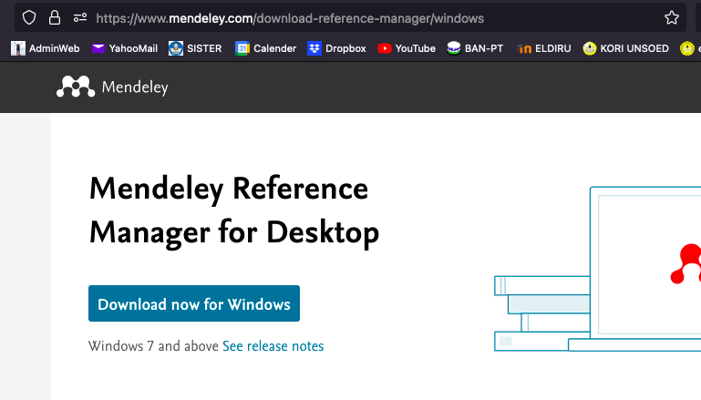

Slide 7
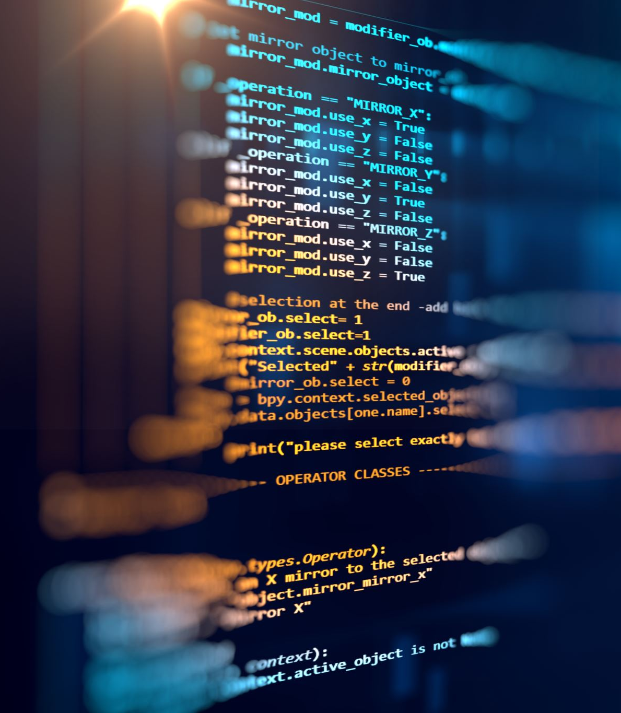
Mendeley
Setelah di-install
Versi web dan Desktop
Bisa sinkronisasi
Pasang add on di Browser dan di MS-Word

Slide 8
Systematic Literature Review (SLR)
Suatu tinjauan literatur yang sistematis bertujuan untuk mengidentifikasi mengevaluasi, dan menginterpretasikan temuan studi-studi primer (Barricelli et al., 2019)

Slide 9
Motivate the topic the research question
Identify the relevant literature in a systematic way
Choose the right balance between breadth (luas) and depth (dalam)
Focus on concepts, not studies
Derive meaningful conclusions
Follow a coherent (masuk akal, rasional) article structure

Slide 10
Langkah-langkah dalam SLR

Slide 11
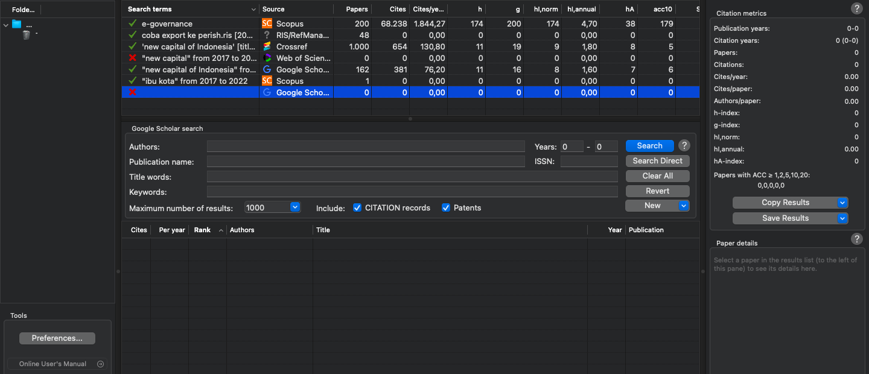
Publish or Perish

Slide 12
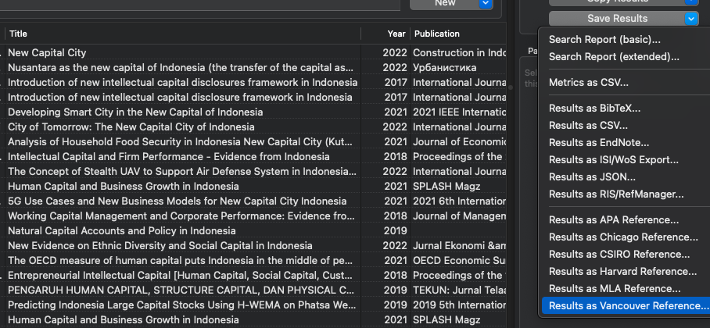
PoP and Mendelay

Slide 13
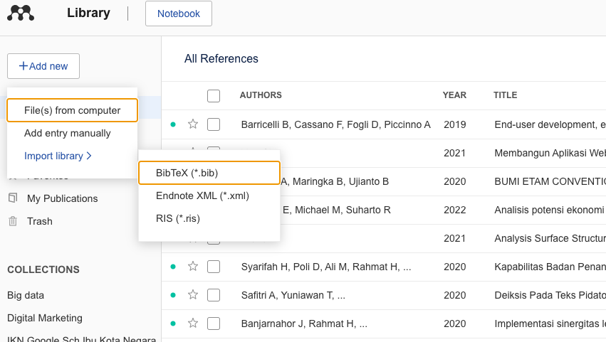
Import library

Slide 15
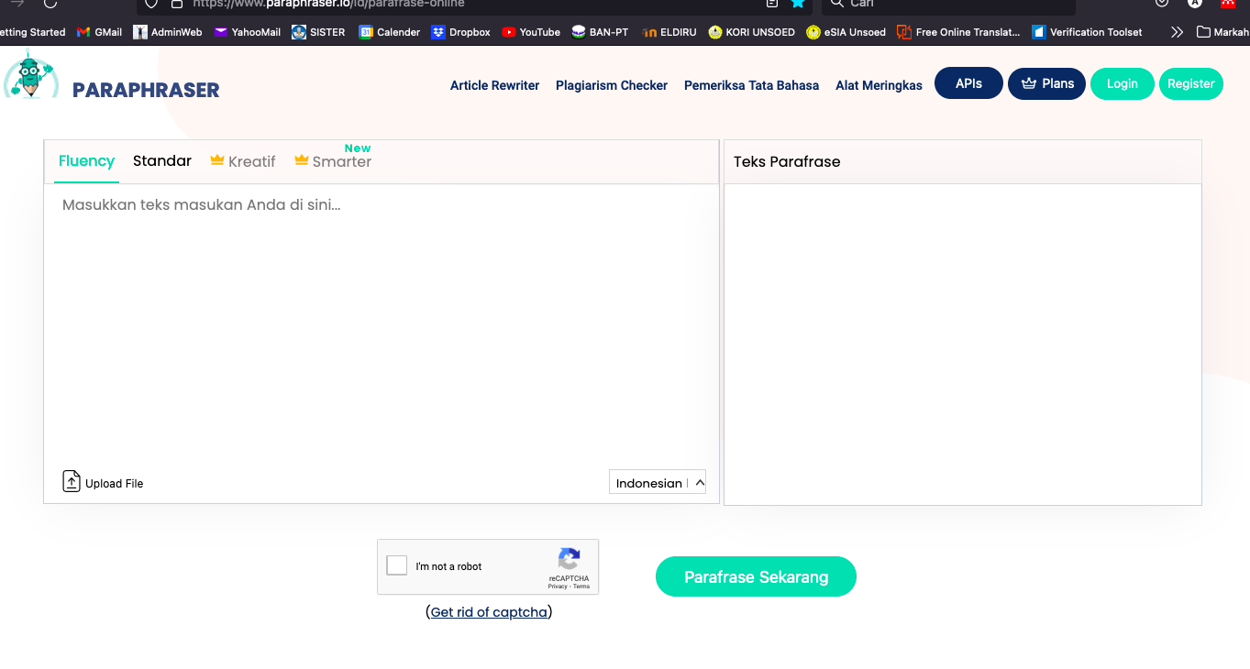

Slide 16
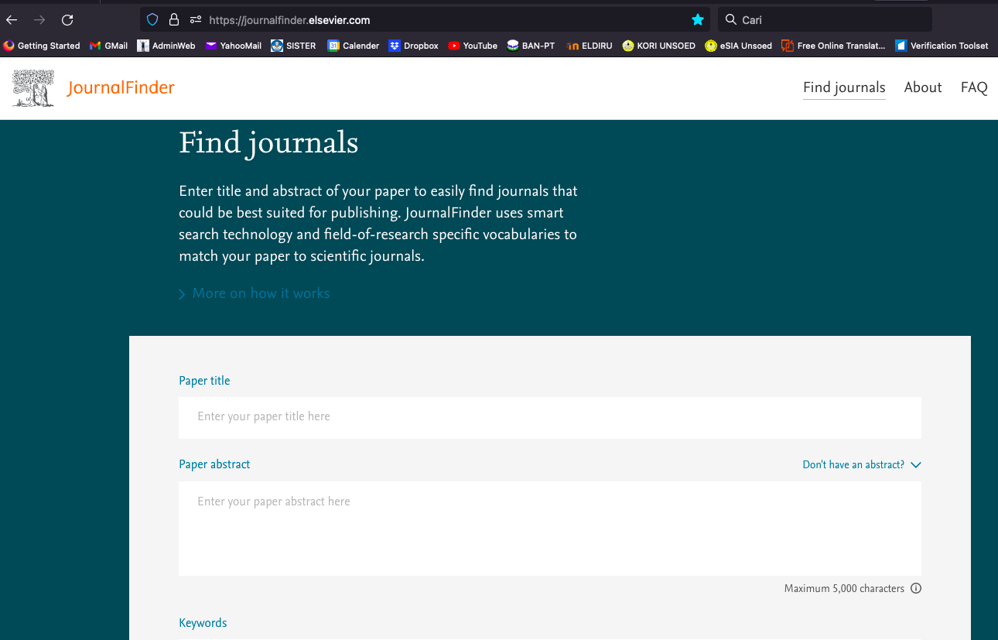

Slide 17
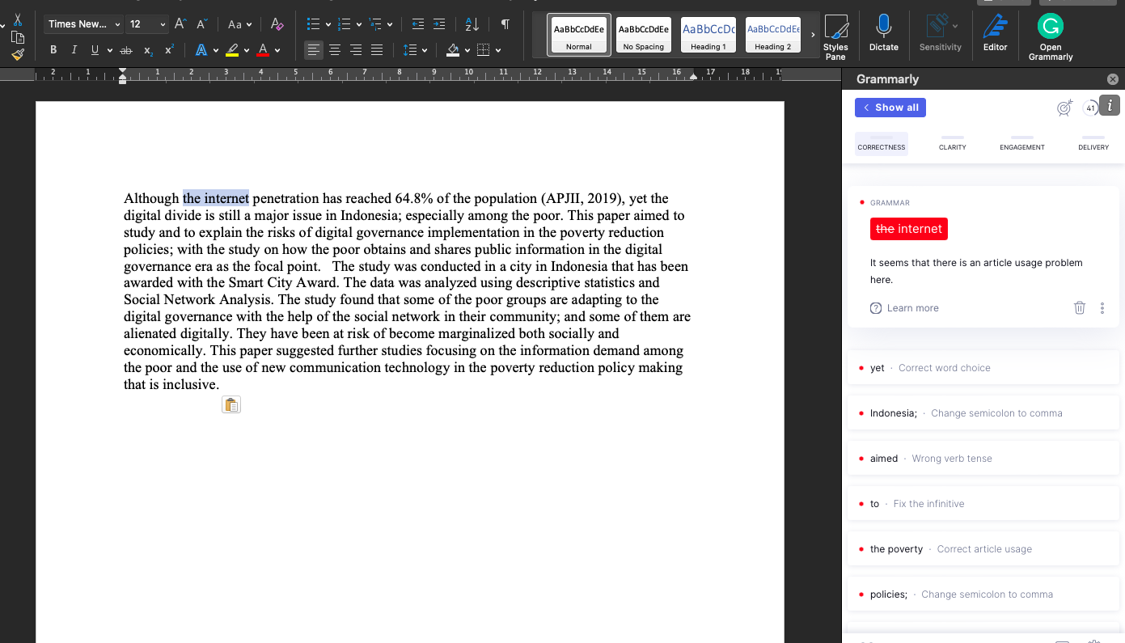

Slide 18
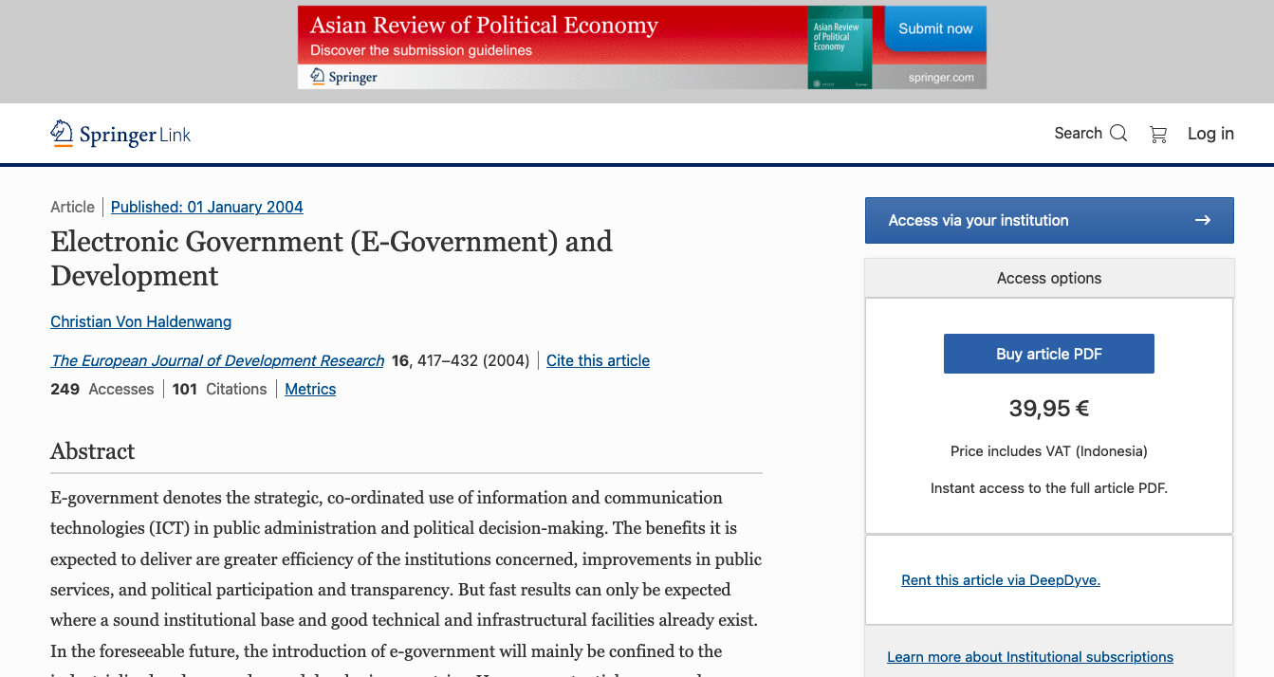

Slide 19
Selamat mencoba
Perjalanan Seribu Mil Selalu Dimulai dengan Langkah Pertama

