Slide 1
Digital Transformation in the Public Sector in the Metaverse Era
Ali Rokhman
Program Studi Administrasi Publik
Universitas Jenderal Soedirman
Disampaikan pada Diskusi Publik
Diselenggarakan oleh Himpunan Mahasiswa Administrasi Publik
FISIP UNSOED 13 Februari 2022

Slide 2
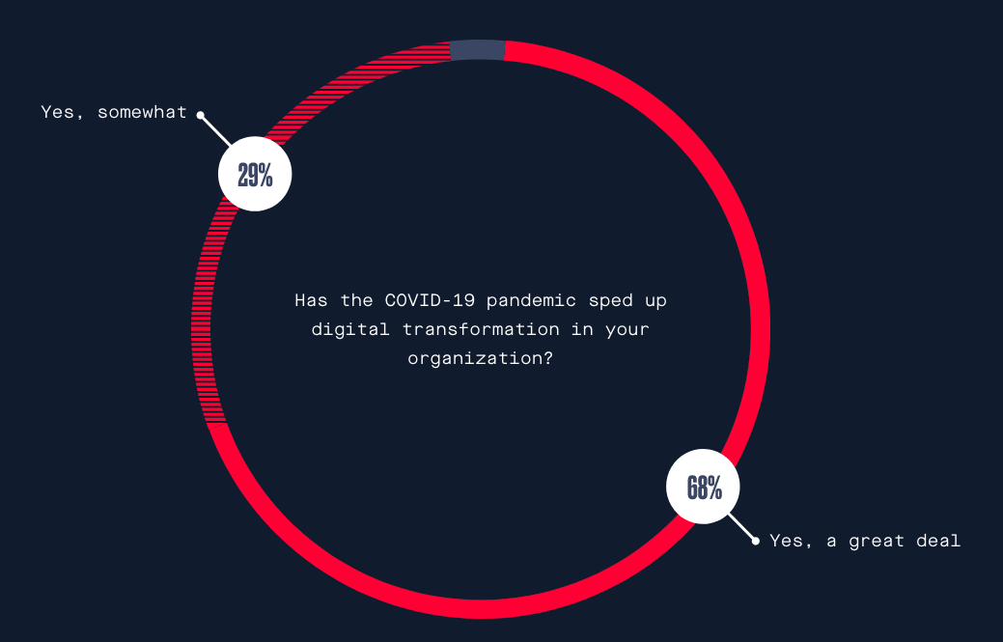
Agak
Banyak sekali
https://www.twilio.com/covid-19-digital-engagement-report#main-content

Slide 3
Adam Lashinsky Fortune Data Sheet
Pandemi mempercepat perubahan yang terpaksa harus terjadi. Konsekuensi dari transformasi digital sangat besar dan “menakutkan”. Setiap pegawai, setiap pemimpin, dan setiap organisasi akan terpengaruh olehnya, dan banyak yang akan tertinggal
https://www.twilio.com/covid-19-digital-engagement-report#main-content

Slide 4
Dampak Pandemi
GOVERNMENTS AROUND THE world are beginning to reopen not only their economies but their own offices and operations. [Membuka diri untuk berubah]
Governments will need to adopt a new operating model based on the uncertain environment we now live in the “next normal” of work.
What should governments stop doing and what should continue from the COVID-19 response?
How can they radically accelerate digitalization?
Deloitte Center for Government Insights

Slide 5
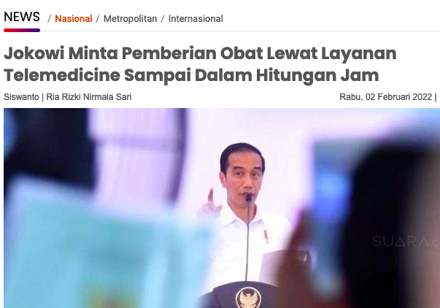
Governments should strive to transform their operations not only in health care (karena Pandemi) but in areas like service delivery, workforce, regulation, and procurement.
Deloitte Center for Government Insights

Slide 6
What is digital transformation?
Digital transformation is the integration of digital technology into all areas of a business (urusan), fundamentally changing how you operate and deliver value to customers. It’s also a cultural change that requires organizations to continually challenge the status quo, experiment (berani mencoba), and get comfortable with failure (tidak takut gagal)
https://enterprisersproject.com/sites/default/files/what_is_digital_transformation_2020.pdf

Slide 7
Digital Transformation in the Public Sector
(https://whatfix.com/blog/digital-government-transformation-post-covid/)
Digitalization of governmental processes – from:
providing easier and better customer experience [sistem pelayanan berubah]
implementing policies that allow for a distributed workforce [pegawai bisa kerja dari manapun]
and improving and optimizing processes [perbaikan dalam sistem dan prosedur kerja]
save money and resources

Slide 8
Digital Transformation in Public Sector meliputi
The Workplace & Workforce
Service Delivery
Pace and Process

Slide 9
The Workplace & Workforce
Line-of-sight supervision (pengawasan secara langsung) is no longer a mandate given the concept of a remote workplace.
WFO dan WFH
With increased digitization, governments can easily access the work records and performance of their employees

Slide 10
Service Delivery
COVID-19 is forcing governments to look at service delivery in a different light (lebih mudah)
Conventional belief dictates that personalization requires the human touch. On the contrary, digital technology provides a more accessible and personalized service.
Digital platforms and applications tend to have a simple and user-friendly interface. They try to incorporate user feedback at every stage, thereby making the user experience more engaging and personalized. For instance:
UK and USA →Digital courts in the pandemic. Conducting hearings through teleconferencing platforms.
the Spanish government has deployed an AI-powered chatbot called ‘Hispabot’ to answer over 200 questions from detailed symptoms of the widespread disease to emergency numbers.
Digital identity has received wider acceptance. Verifikasi secara fisik tidak lagi menjadi keharusan. For instance:
in Chile, a digital ID system allowed people to enroll themselves in social programs as beneficiaries. [Seperti pendaftaran BLT atau kartu pra-kerja]

Slide 11
Pace and Process
Pace:
Mengurangi tahap atau prosedur
Tidak banyak meja (tanda tangan pejabat) yang harus dilalui
Process:
Tidak ada persyaratan yang dupilkasi
Tidak berbasis kertas
Tanda tangan digital
Pemenuhan persyaratan dokumen diupload

Slide 12
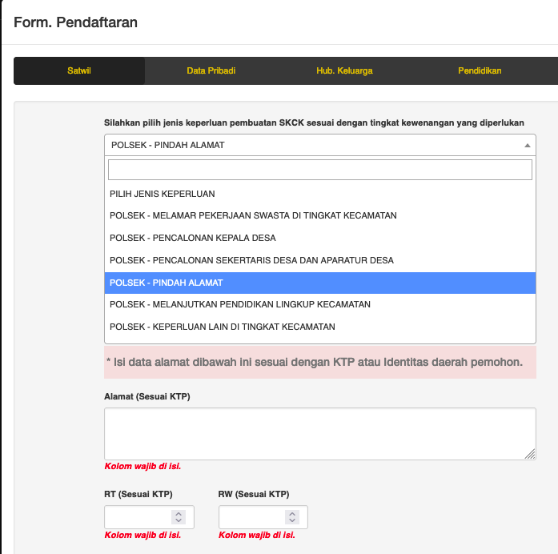
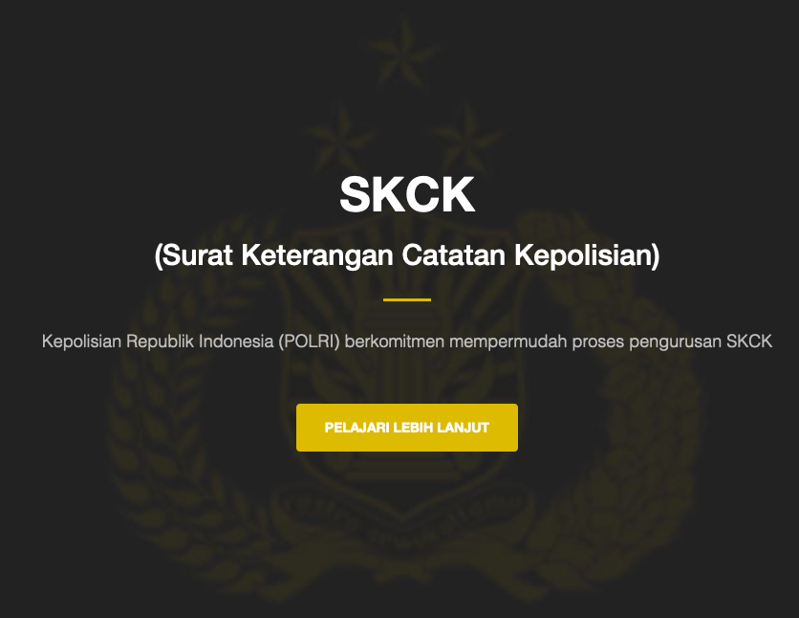
Mendaftar secara online dengan cara mengunggah dokumen yang dipersyaratkan serta mengisi form yang tersedia

Slide 13
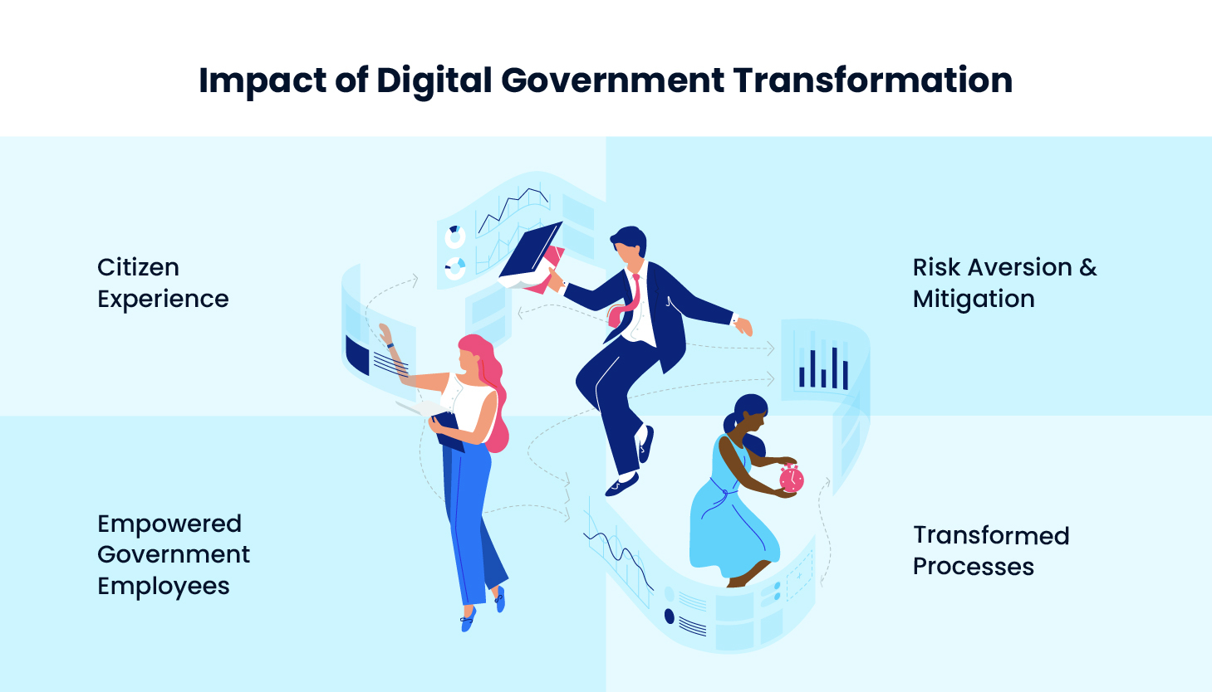
https://whatfix.com/blog/wp-content/uploads/2021/02/impact-of-government-digital-transformation.jpeg
Better engagement and collaboration with citizens. There’s an increased level of trust in the government.
Data is at the heart of digital government strategy. the decision-making process has become data-driven and improved drastically.
Bridge the skill gap by providing employees with improved and personalized learning experiences.
The procurement process, for instance, has become simplified, flexible, and fast-paced.

Slide 14
Bagaimana Indonesia?

Slide 15
Di era disrupsi saat ini Jokowi berharap seluruh anggota Korpri harus mau dan harus mampu beradaptasi dengan perubahan. Caranya dengan terus meningkatkan kompetensi diri sehingga menjadi trendsetter, bukan sebatas follower
Dengan kemajuan teknologi, tidak ada lagi toleransi bagi layanan yang rumit dan lama. Jangan terpaku pada cara-cara lama. Segera terapkan cara-cara baru
Jokowi meminta Korpri memanfaatkan teknologi, dan menerapkan e-government. Sebab teknologi telah memungkinkan pelayanan kepada masyarakat dilakukan lebih cepat dan lebih akurat.
https://nasional.kompas.com/read/2022/01/28/16450521/jokowi-sudah-sangat-lama-asn-ada-di-zona-nyaman-terbelenggu-birokrasi-feodal?page=all

Slide 16
Indonesia Digital Nation - A Journey of Digital Transformation - IPC HM2021
https://www.youtube.com/watch?v=jTkNAtlkgjQ

Slide 17
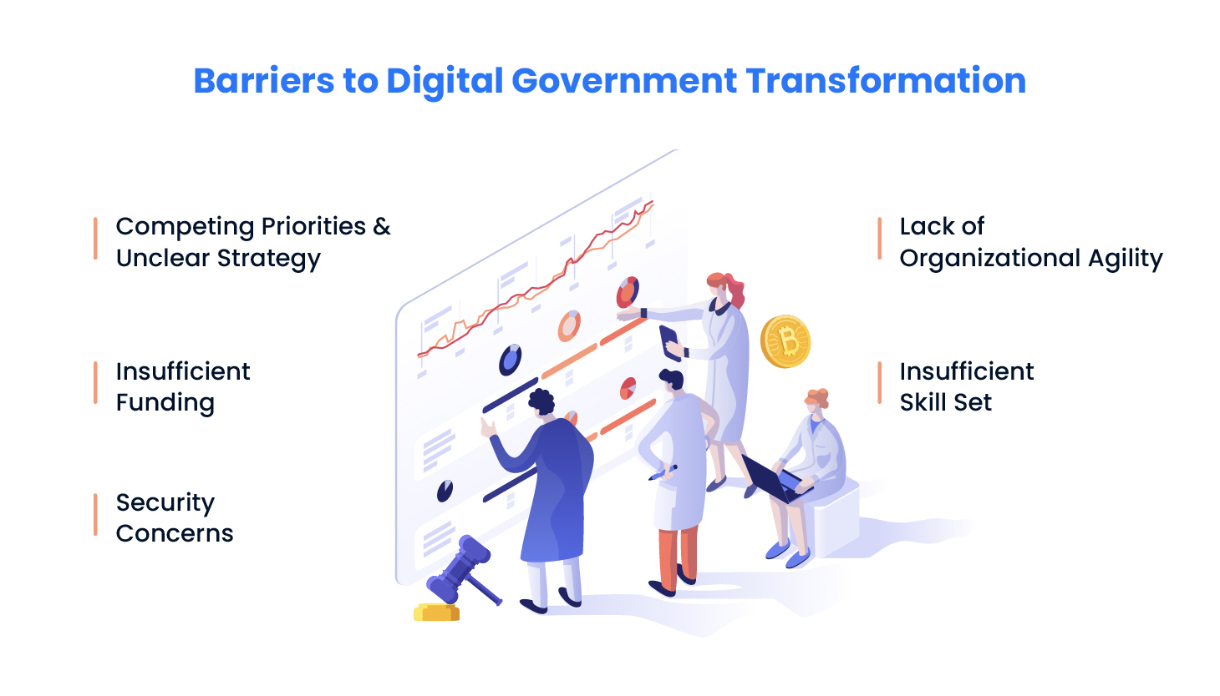
Barriers to Digital Government Transformation
https://whatfix.com/blog/wp-content/uploads/2021/02/barriers-to-digital-government-transformation.jpeg

Slide 18
Hambatan
Lack of clear strategy
Getting executive approval
Reluctance to replace legacy software
A lack of time.
https://www.twilio.com/covid-19-digital-engagement-report#main-content

Slide 19
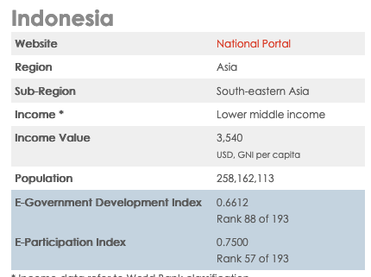
Kesiapan Indonesia: Peringkat E-Government
World 0.5988
World 0.5677
https://publicadministration.un.org/egovkb/en-us/Data/Country-Information/id/78-Indonesia

Slide 20
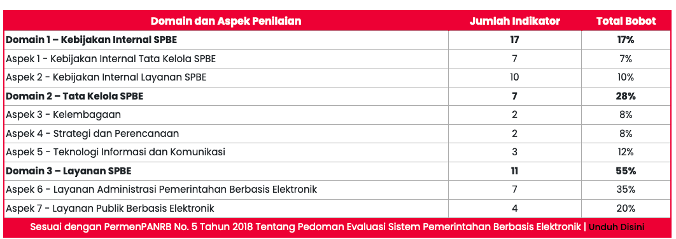
Evaluasi Sistem Pemerintahan Berbasis Elektronik (SPBE) pada kementerian, Lembaga, dan pemerintah daerah, Kepmenpan RB tahun 2021
https://web.kominfo.go.id/sites/default/files/KOMINFO%20LAMPIRAN%20KEPMENPANRB%201503%20HASIL%20EVALUASI%20SPBE%202021%20517%20KLD.pdf

Slide 21
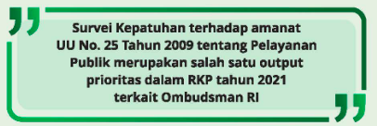
https://ombudsman.go.id/produk/lihat/657/SUB_PI_5a1eaa2285f15_file_20220117_191352.pdf

Slide 22
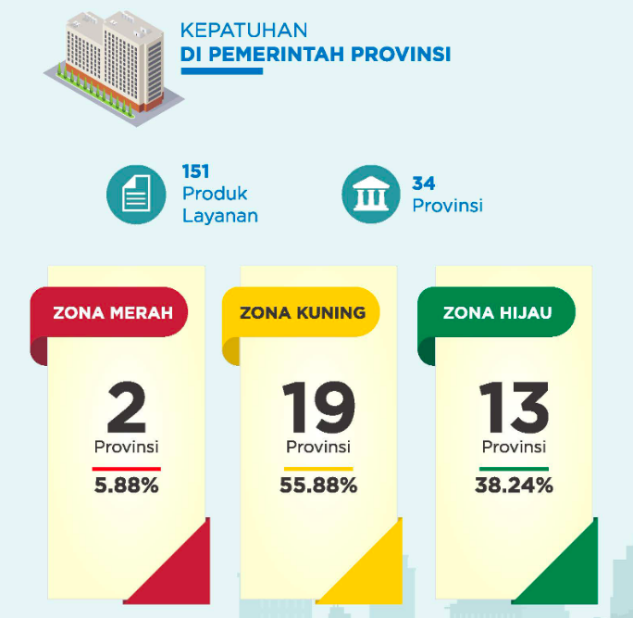
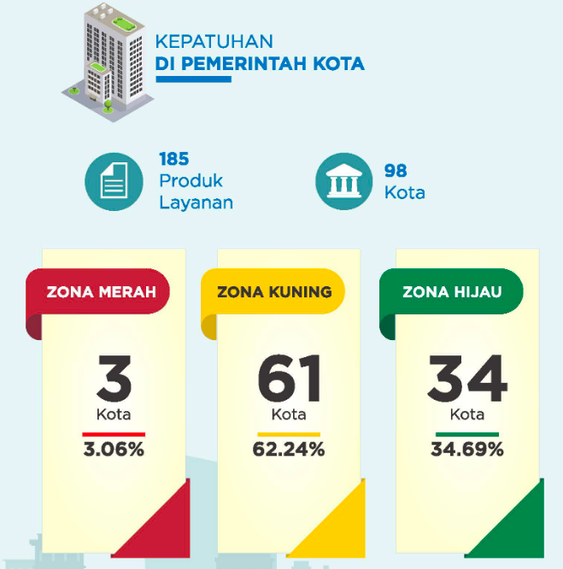

Slide 23
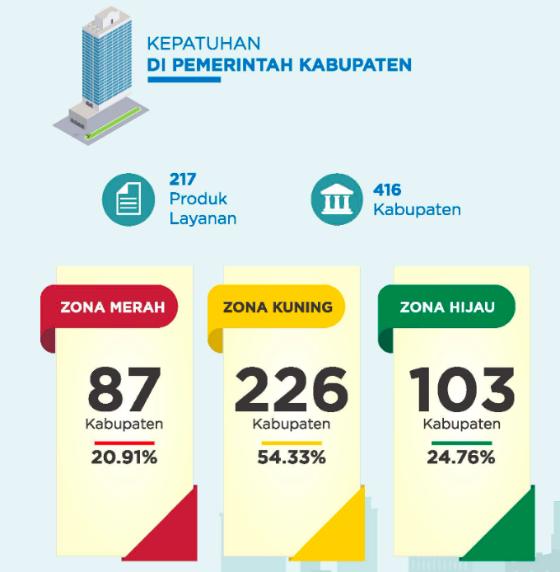
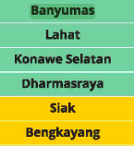
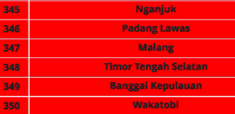

Slide 24
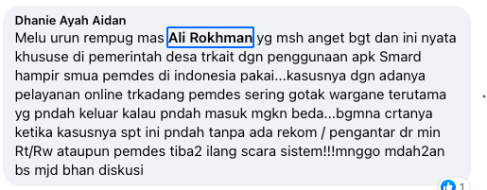
Suara publik

Slide 25
My opinions
Belum sepenuhnya siap bertransformasi → Culture shock
Kurang perencanaan
By design and by accident
E-Office belum bisa diterapkan
Sistem informasi belum dimaksimalkan dan belum terntegrasi
Butuh literasi digital
Butuh digital leadership

Slide 26
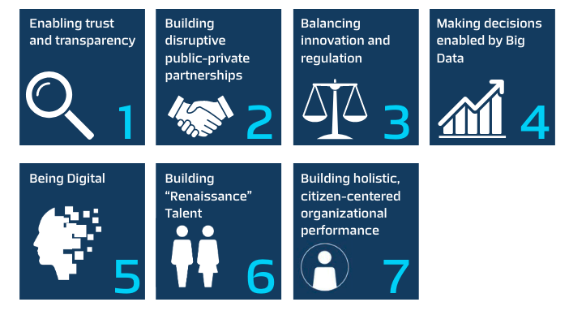
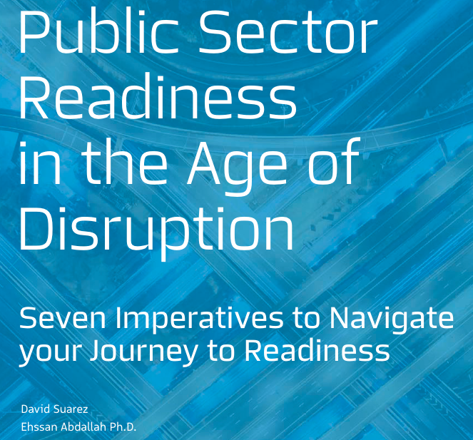
Tujuh prinsip menuju kesiapan transformasi digital

Slide 27
Building renaissance talent
SDM harus siap berubah
Melahirkan Kembali SDM yang siap bekerja di era digital
Rekruitmen diarahkan
Eksisting SDM dikembangkan kapasitasnya
Pembentukan digital culture
Namun tetap nilai-nilai kemanusiaan

Slide 28
Balancing innovation and regulation
Akar masalah dalam organisasi public
Inovasi adalah perubahan
Seringkali aturan terlambat untuk menyesuaiakn
Bagaimana aturan kehadiran dalam WFH
Banyak ego sectoral
Organisasi privat lebih fleksibel

Slide 29
Terima kasih

Slide 32
Digital Transformation in the Public Sector in the Metaverse Era

